Slide 1
Logic Design
Abstraction Levels

Slide 2
The von Neumann Architecture
All general purpose computers are now based on the key concepts of the von Neumann architecture:
  A single read-write memory for data and instructions
  The memory is addressable by location in a way which does not depend on the contents of the location
  Execution proceeds using instructions from consecutive locations unless an instruction modifies this sequentiality explicitly
The von Neumann bottleneck: a single channel for both instructions and data
Harvard Architecture: separate memories - double the bandwidth of the simple von Neumann architecture

Slide 3
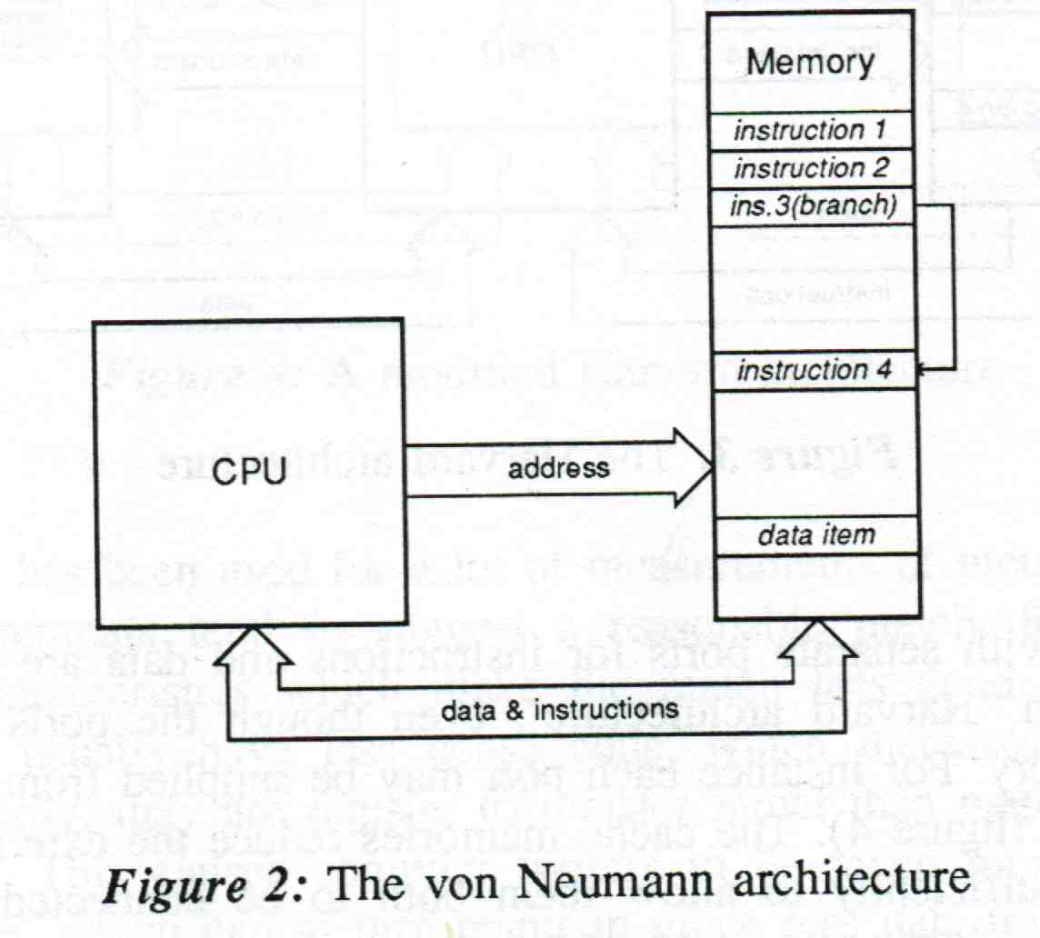
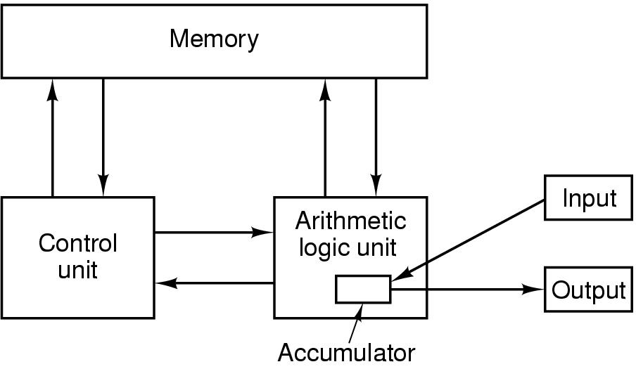
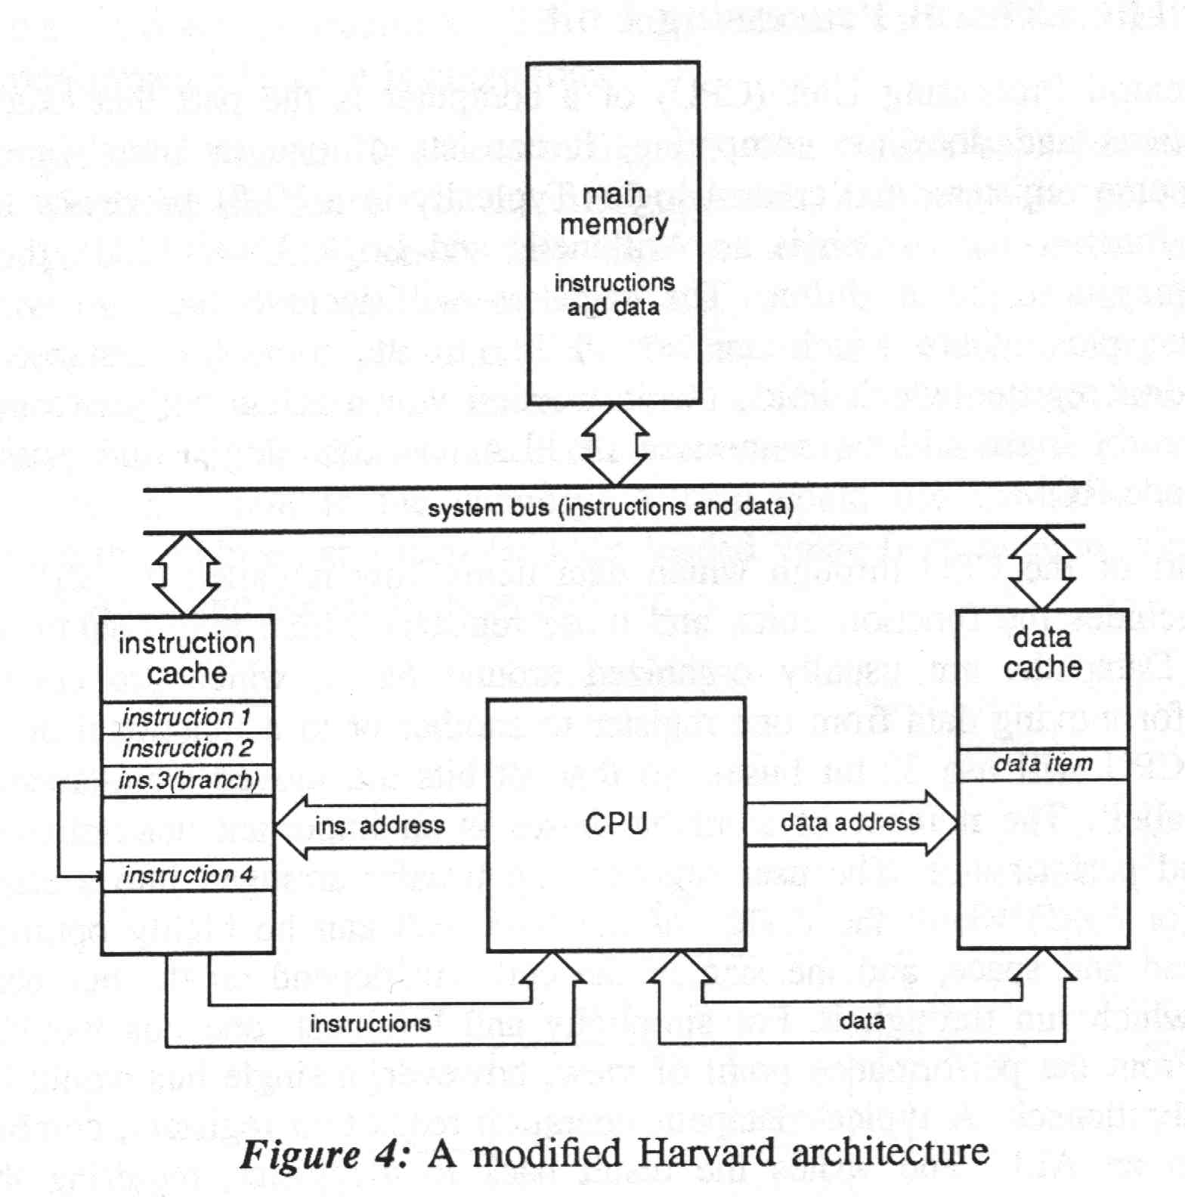
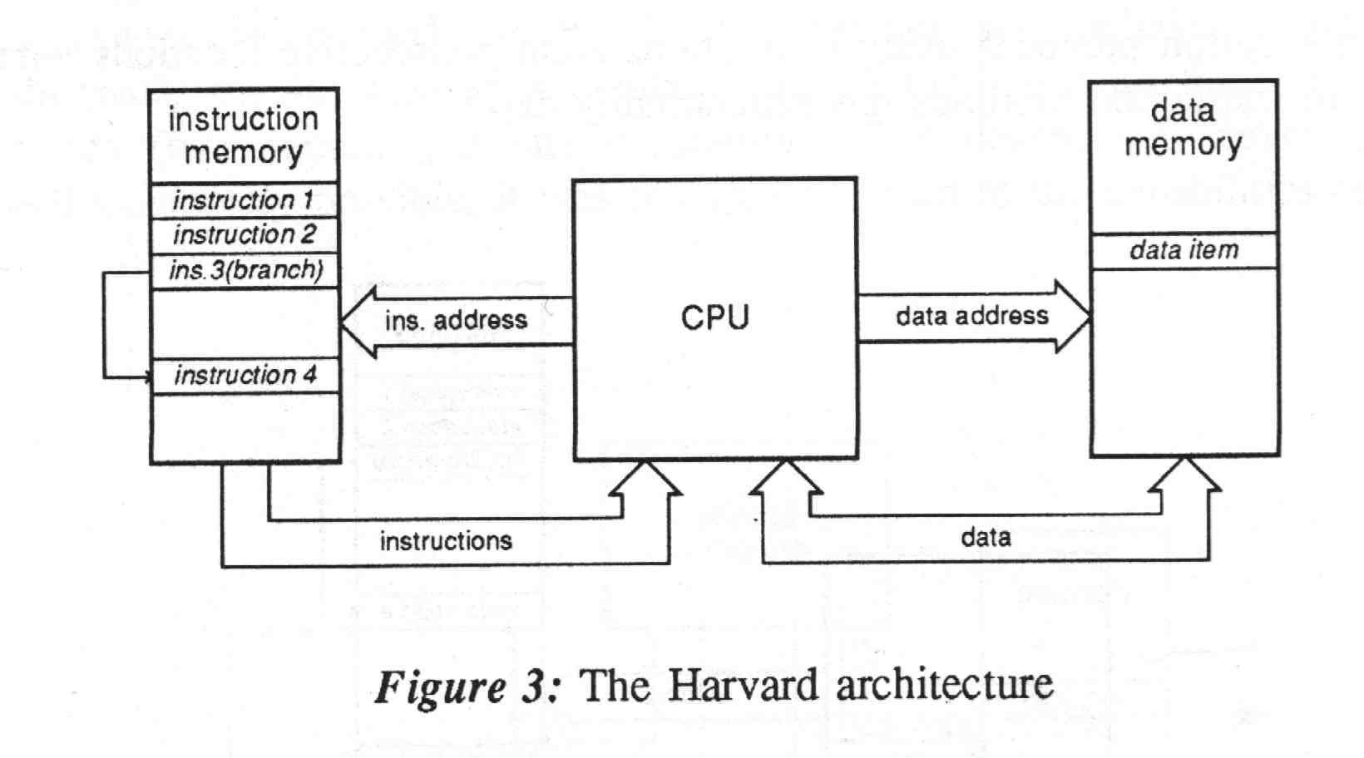
The von Neumann and Harvard Architectures

Slide 4
Computer Components
CPU
  Datapath
  Control
Memory (hierarchy)
  Main Memory
  Secondary memory
  Cache
I/O devices
Buses (external and internal to CPU)

Slide 5
Instruction Execution: The Fetch-Decode-Execute Cycles
The CPU executes instructions in a series of small steps:
  Fetch the next instruction from memory in the Instruction Register (IR)
  Change the Program Counter (PC) to point to the following instruction
  Determine the type of fetched instruction
  If the instruction uses a word in memory, determine where it is
  Fetch the word, if needed, into the CPU
  Execute the instruction
  Go to step 1

Slide 6
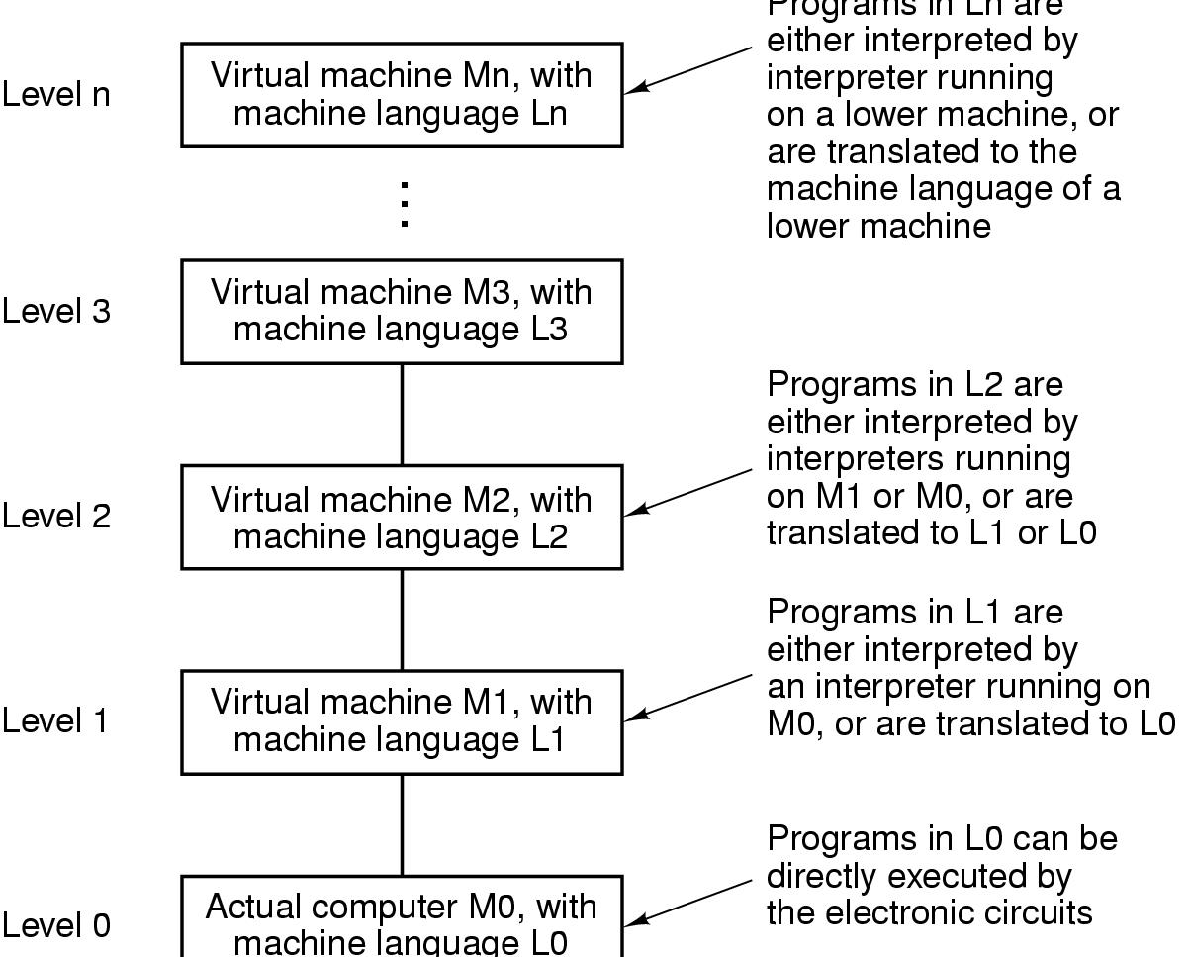
Multi-Level Approach

Slide 7
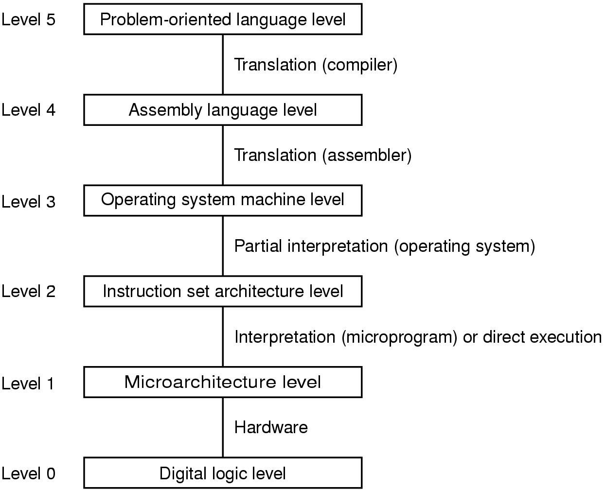
Contemporary Typical Multilevel Machines
Digital Logic design. Gate level
Micro-architecture Level
  Programming Model (Registers)
  Datapath & Control
Instruction Set Architecture Level-ISA
  Instruction types and formats
  Addressing

Slide 8
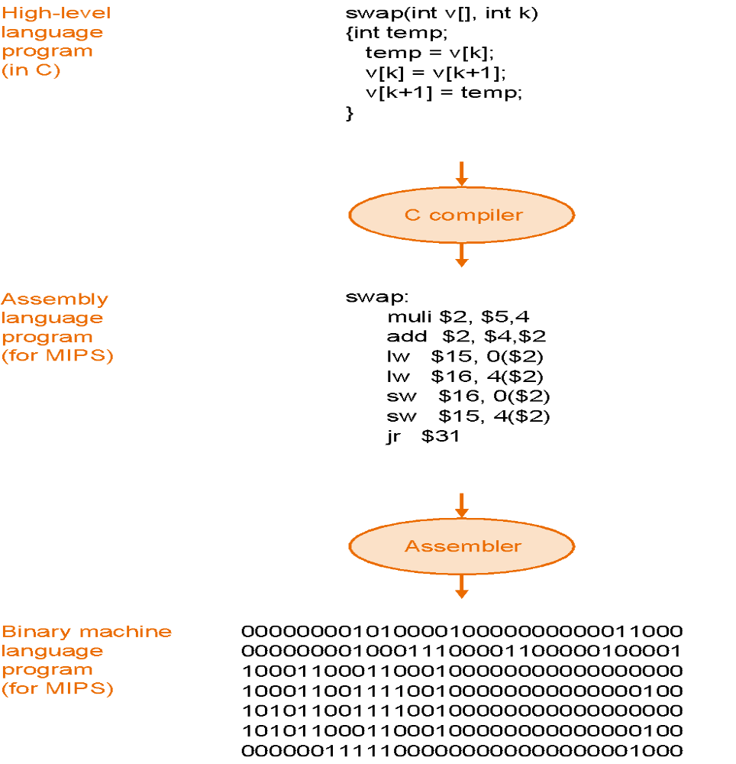
Translation Example

Slide 9
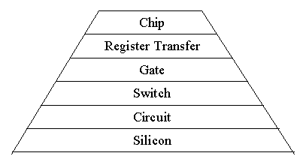
Computer Architecture Description Levels

Slide 10
Silicon Level
The real geometry of the physical layout of materials such as diffusion, polysilicon, and metals on the silicon surface.
Schematic, graphical or textual layout representation.
The layout is a symbolic, non-mathematical model, a purely morphological description, without any behavioural information incorporated.

Slide 11
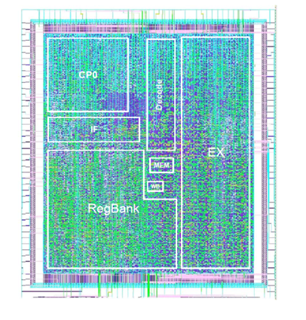
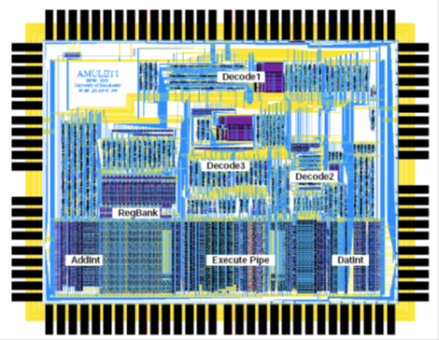
Example Silicon Level Descriptions

Slide 12
Circuit Level
System expressed in terms of traditional passive and active electrical circuit components (e.g resistors, capacitors and transistors).
Circuit specified as a schematic diagram or via a textual description (net list). The circuit net list may be specified explicitly or be extracted from the physical layout or circuit schematics.
Input and output of each component in the model have analogue values. The analogue behavior of the components at this level is typically expressed in terms of differential equations which may be solved by a circuit simulator (e.g. SPICE)
Circuit simulators typically use as input the circuit net list.

Slide 13
Switch Level
System described at the same level of abstraction as in the circuit level, however only digital, rather than analogue, signal values are considered: {1,0}, {on,off}, {high, low}.
The same circuit diagram and circuit net list are used, but components are modelled in a much simpler way: Instead of a precise analogue behaviour only the digital behaviour is described.
Transistors are modelled as switches, with two states, ``on" (low impedance) and ``off" (high impedance). A model at switch level, and all levels above that, may be simulated using a discrete event simulator.

Slide 14
Gate Level
The logic design level, where the implementation of the system in terms of gates (AND, OR, inverters etc) and flipflops is described.
Description provided graphically, by means of a logic diagram, or textually, using a Hardware Description Language
A gate level net list may be automatically extracted from the schematic or textual specification. The net list may be provided as input to a discrete event logic simulator.
Gate level has traditionally been the main design level for digital systems.

Slide 15
Register Transfer Level (RTL)
The system is expressed in terms of higher level components such as registers, counters, multiplexers, ALUs, multipliers, shifters, memory blocks etc. ( functional blocks, functional level modelling).
RTL components are primitive behavioural models directly expressed using a functional HDL (In principle, though, RTL components may be expressed in terms of an interconnection of lower level primitives e.g gates)
RTL models may be simulated by a functional discrete event simulator.

Slide 16
Chip (Architectural) Level
The structural primitives of the model are blocks such as processors, memories, serial and parallel ports, interrupt controllers etc.
Typically, the model boundaries are defined by the chip boundaries, however this requirement is not restrictive (e.g. when modelling parallel architectures, where the system consists of more that one chip).
As with the functional blocks in RTL, chip level components are primitive behavioural models and are not specified hierarchically in terms of lower level blocks.
Discrete event simulation is employed for the execution of chip level models.

